Slide 1

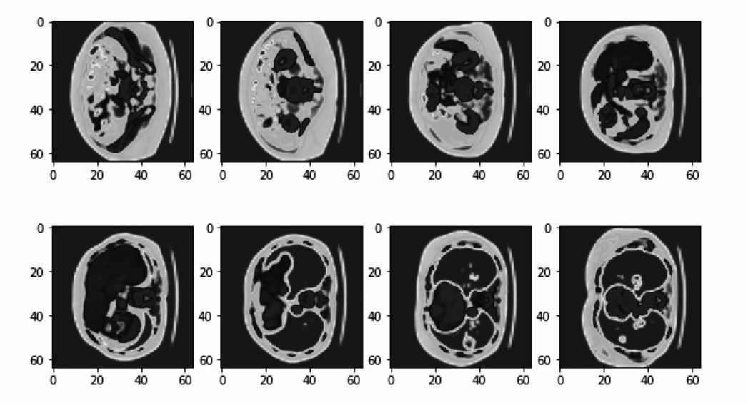
SN-GAN for LITS
By Abhilash Datta
18 August 2021

Slide 2
Main Updates
Resolved the problem of ‘only-background’ output.
Better Visualizations using Color Maps.
Learning Rate schedulers.
Fine-tuned hyper-parameters.

Slide 3
Code Optimizations
Parallelly processed the data loading and preprocessing code for faster data generation.
Changed the training loop for loss calculations and better inferences.

Slide 4
Hyper-parameters
Fine - tuning
Shrinked the noise vector dimension.
Increased Batch size for better generalization.
Scheduled the learning rate for reduction on plateaus

Slide 5
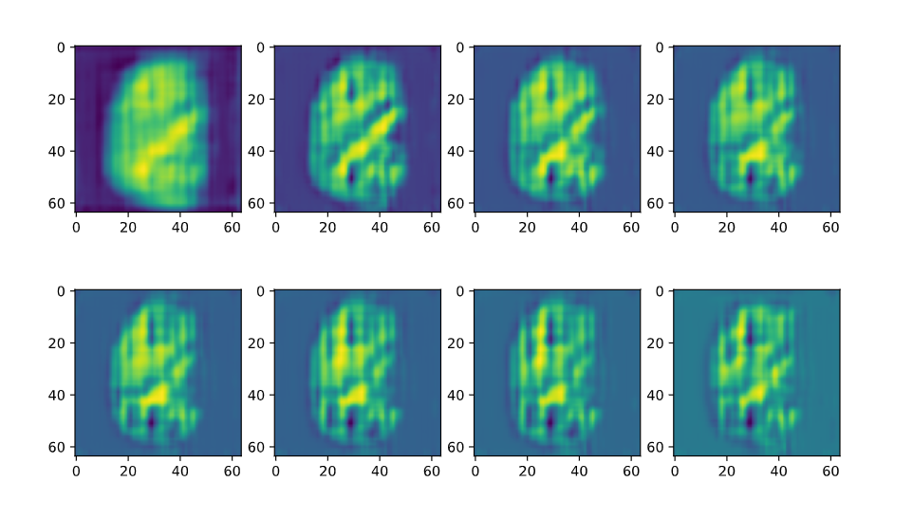
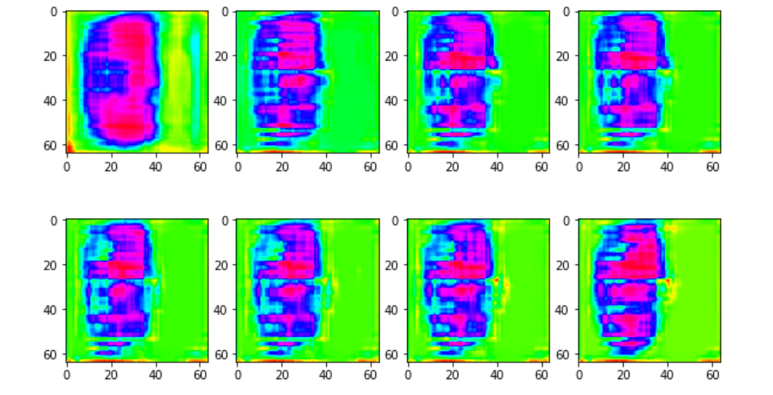
Better than Nothing!
Without Color Map
With Color Map
Current Generation

Slide 6
Current Problems
How to make the GAN learn more deep features?
Some ideas -
More training.
More updates per epoch.
Reducing learning rate.

Slide 7
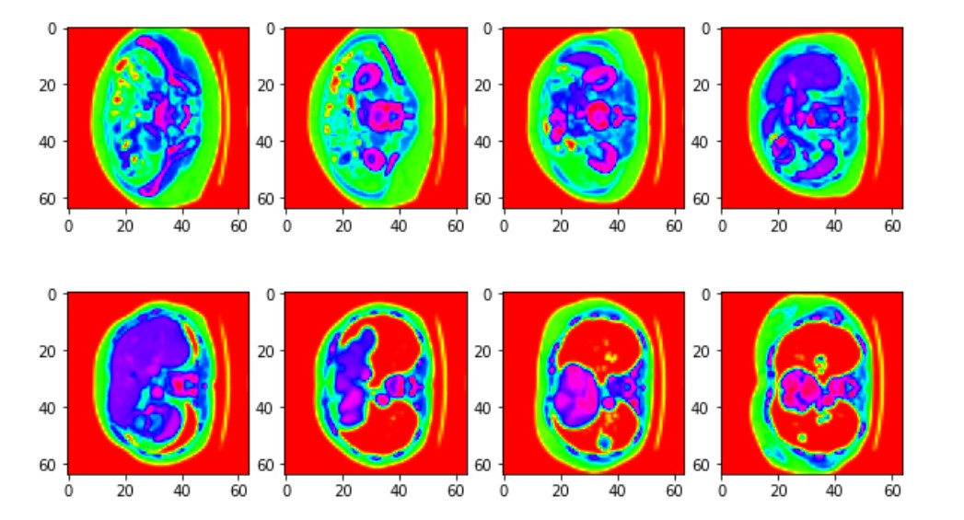
Only specific boundary not features
(Current Stage)
Specific boundary and features
(Target)

Slide 8
Current Problems
2. How to ensure convergence?
Some ideas -
Loss Plots.
Visualizations
Frechet Distance

Slide 9
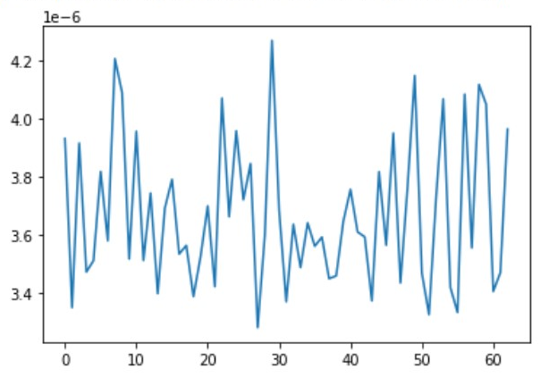
Inconclusive Loss Plots
1
Same shaking plot even for 100 iterations.
Iterations

Slide 10
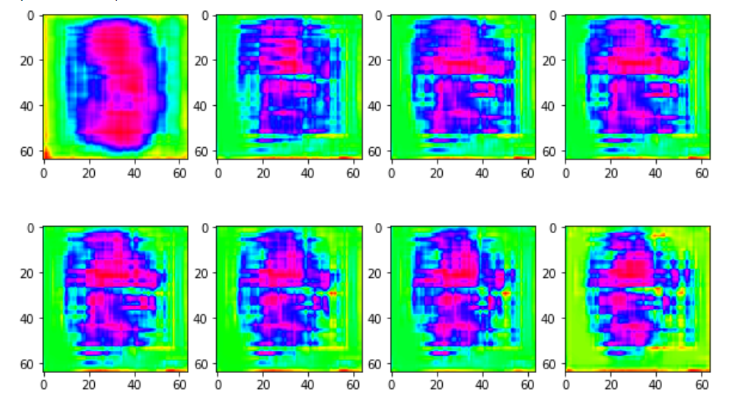
Two Consecutive Iterations
Somewhat certain boundary
Shattered boundary

Slide 11
Conceptual Enhancements
Better Loss Function
Better Visualizations
Training on different initial weights
Fine-tuned hyper-parameters.
Faster Training
...

Slide 12
That’s All!
Innovative Ideas are welcomed anytime.
Thank You

